Slide 1


Optimized Implementation of Convolution Neural Network
Names of the Interns: Names of the Supervisor:
Aishwarya Joshi Dr. Vijaypal Singh Rathor
Krishna Kothagorla
Mahima Kothari
Mayank Goyal
Prapti Darvekar

Slide 2
Introduction
A Convolutional Neural Network (ConvNet/CNN) is a Deep Learning algorithm which can take any image from the user. It then assigns importance to various aspects/objects in the image. It is able to differentiate one from the other.
In recent years, CNN has been widely used in many image-related machine learning algorithms since its high accuracy for image recognition.
Convolutional neural network is composed of multiple building blocks, such as convolutional layers, pooling layers, and fully connected layers, and is designed to automatically and adaptively learn spatial hierarchies of features through a backpropagation algorithm.

Slide 3
Objective
To develop an optimized software model (using Python with TensorFlow or Torch, etc.) of a CNN architecture by applying the ternary weights along with using dual indexing module (DIM).
The proposed model must reduce the computation as well storage space required during training and testing the model while providing acceptable accuracy.

Slide 4
Methodology and Model Used
In our project, we have combined two existing methods to overcome each others drawbacks. The existing methods are:
(i) Sparse Ternary Connect(STC)
(ii) Dual Indexing Module(DIM)

Slide 5
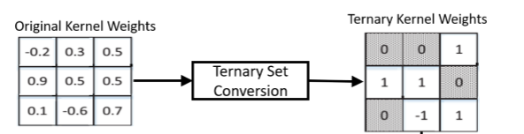
(i) Sparse Ternary Connect(STC):
In this work, we develop a weight representation method not only to highly compress the network but also to implement it very efficiently in real-time.
The proposed algorithm trains the network so that the weights are represented using a structured sparse ternary format.
This format allows +1 or -1 only at specified locations, while most of the values are pruned to zero.
Fig 1

Slide 6
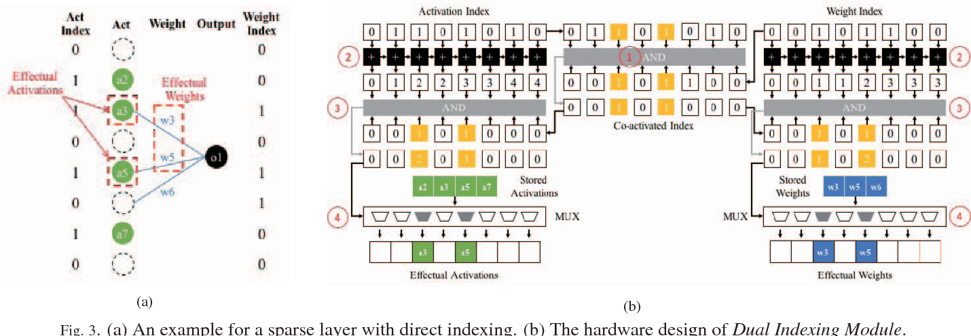
(ii) Dual Indexing Module(DIM):
In this work, a Dual Indexing Module (DIM) is proposed to efﬁciently handle the alignment issue where activations and weights are both kept in compressed-sparse format.
Dual Indexing Module effectively and efﬁciently handle the alignment of irregularly distributed non-zero data.
The indices of activations and weights are checked in parallel and the effectual activation/weight pairs can be identiﬁed and allocated for computation.
Fig 2

Slide 7
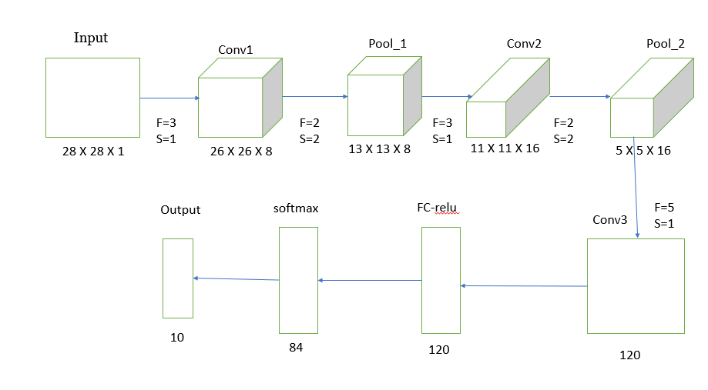
The architecture we used in this work is LeNet. The LeNet architecture is an excellent “ first architecture” for Convolutional Neural Network.
LeNet is small and easy to understand yet large enough to provide interesting results.
Below fig. 3 shows the LeNet Architecture. It consists of the following layers.
Fig 3

Slide 8
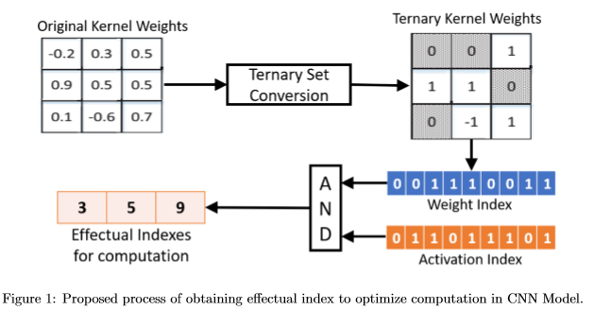
Experimental Setup
In this project we have used three approaches that are
i) Single Layer
ii) Two Layer
iii) LeNet 5 (multilayer)
In this work we have used the combination of both the methods i.e. STC+DIM method to optimize the Convolution Neural network.
STC will help to reduce the time and DIM will improve the accuracy.
When we use both the method in single arch, it will reduce computational time and increase accuracy
Fig 4

Slide 9
Dataset Used : MNIST
The Dataset used in the project is MNIST Dataset.
MNIST stands for Modified National Institute of Standards and Technology.
The MNIST dataset is a large dataset of handwritten digits that is commonly used for training various image processing systems.
The MNIST dataset was constructed from two datasets of the US National Institute of Standards and Technology (NIST).
The test set contains handwritten digits from different people following the same split.

Slide 10
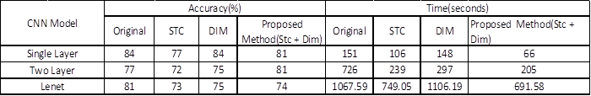
Results And Discussion
Following results are obtained by training 100 images and testing 400 images.
Table 1 shows the comparison of accuracy and time for different approaches.
It is clearly visible that when we use STC and DIM together it will takes less time compare to other method without much loss in accuracy.
Table 1

Slide 11
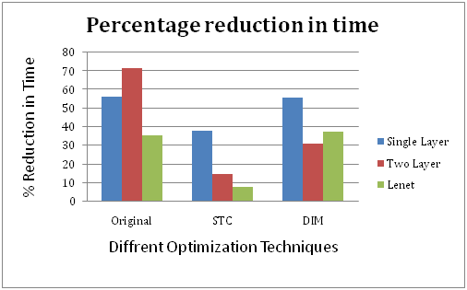
Figure 5 shows the graph of different optimization techniques and their percentage reduction in time.
From the graph we can easily observe that for original CNN and STC we have reduced much time for Lenet-5 as compared to single layer and two layer architectures.
The percentage reduction in time of a single layer for original CNN is 56.29%. The same for two layer, it is 71.76% and for LeNet, it is 35.22%.
The percentage reduction in time of a single layer for STC CNN is 37.73%. The same for two layer, it is 14.22% and for LeNet, it is 7.67%.
The percentage reduction in time of a single layer for DIM CNN is 55.40%. The same for two layer, it is 30.97% and for LeNet, it is 37.48%.
Fig. 5

Slide 12
Discussion
In those results we have observed that for Original CNN, the single layer gives the output in just 151 secs. and with 84% accuracy. The two layer gives the output in 726 secs. with 77% accuracy. LeNet gives the output in 1067 secs. with 81% accuracy.
We have observed that for STC CNN, the single layer gives the output in just 106 secs. and with 77% accuracy. The two layer gives the output in 239 secs. with 72% accuracy. LeNet gives the output in 749 secs. with 73% accuracy.
We have observed that for Original CNN, the single layer gives the output in just 148 secs. and with 84% accuracy. The two layer gives the output in 297 secs. with 75% accuracy. LeNet gives the output in 1106 secs. with 75% accuracy.
STC method gives poor accuracy for every architecture as compare to original CNN. DIM method is giving same accuracy as original one. Two layer architecture giving worst accuracy for each approach Lenet-5 is giving good accuracy for each approach.

Slide 13
Conclusion
From the observations and results achieved, we can conclude that use of Lenet-5 architecture for our CNN model not only reduces computational time but also improves accuracy on dataset.
When we use our proposed method with Lenet-5 it will enhances performance of our model.
Convolutional neural networks (CNNs) have accomplished astonishing achievements across a variety of domains, including medical research, and an increasing interest has emerged in radiology.

Slide 14
Future Scope
Optimizing CNN is going to help in various fields such as
Computer Vision
Scene Labelling
Action Recognition
Human Pose Estimation
Document Analysis
Natural Language Processing

Slide 15
References
C. Jin, H. Sun and S. Kimura, "Sparse ternary connect: Convolutional neural networks using ternarized weights with enhanced sparsity," 2018 23rd Asia and South Pacific Design Automation Conference (ASP-DAC), Jeju, 2018, pp. 190-195, doi: 10.1109/ASPDAC.2018.8297304.
C. Lin and B. Lai, "Supporting compressed-sparse activations and weights on SIMD-like accelerator for sparse convolutional neural networks," 2018 23rd Asia and South Pacific Design Automation Conference (ASP-DAC), Jeju, 2018, pp. 105-110, doi: 10.1109/ASPDAC.2018.8297290.
"Support vector machines speed pattern recognition - Vision Systems Design". Vision Systems Design. Retrieved 17 August 2013.
Gangaputra, Sachin. "Handwritten digit database". Retrieved 17 August 2013.
Qiao, Yu (2007). "THE MNIST DATABASE of handwritten digits". Retrieved 18 August 2013.
Platt, John C. (1999). "Using analytic QP and sparseness to speed training of support vector machines" (PDF). Advances in Neural Information Processing Systems: 557–563. Archived from the original (PDF) on 4 March 2016. Retrieved 18 August 2013.

Slide 16
Thank You

